Slide 1



SMARTPENSION
RETIREMENT PLANNING APPLICATION
M Shaqif Syauqi Bin M Syukri – 20014235
Arslan Haider – 20000154
Vedant Tomer – 20015122
Muhammet Furkan Yavuz - 20014641

Slide 2





AGILE TEAM
SHAQIF SYUKRI
ARSLAN HAIDER
VEDANT TOMER
FURKAN YAVUZ
Scrum Master
Developer
Product Owner
Data Engineer

Slide 3
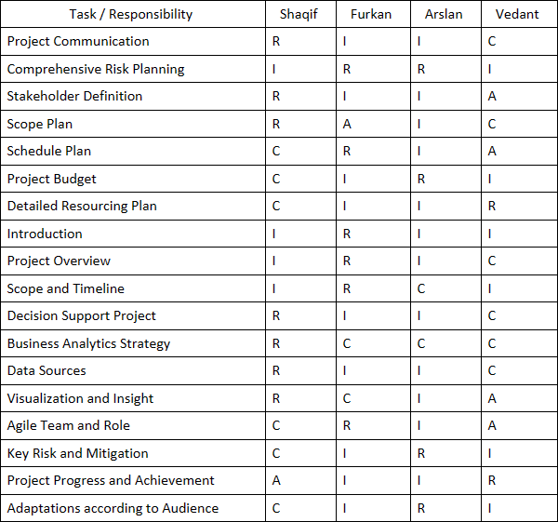
RACI MATRIX
Legend:
R: Responsible
A: Accountable
C: Consulted
I: Informed

Slide 4

SMARTPENSIONS
REVOLUTIONIZING RETIREMENT PLANNING
A CUTTING-EDGE DECISION SUPPORT SYSTEM TAILORED FOR MODERN FINANCIAL NEEDS.

Slide 5




PROJECT OVERVIEW
RETIREMENT PLANNING
TAX OPTIMIZATION
Revolutionize retirement planning through the integration of a decision support system powered by machine learning.
GOAL TRACKING AND MONITORING
INVESTMENT GUIDANCE

Slide 6



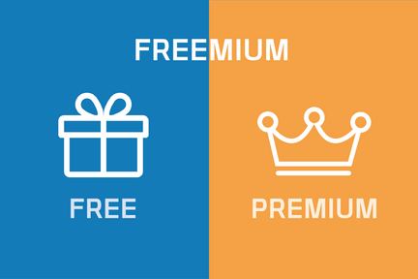
GAINING CLIENTS
DIGITAL MARKETING
PARTNERSHIPS
Our strategy to attract and retain clients involves a multi-faceted approach
USER EXPERIENCE
FREEMIUM MODEL

Slide 7



DECISION SUPPORT PROJECT
MACHINE LEARNING MODELS
USER DATA INTEGRATION
Designed to assist users in making informed decisions about their retirement planning
INTERACTIVE TOOLS
CONTINUOUS LEARNING

Slide 8

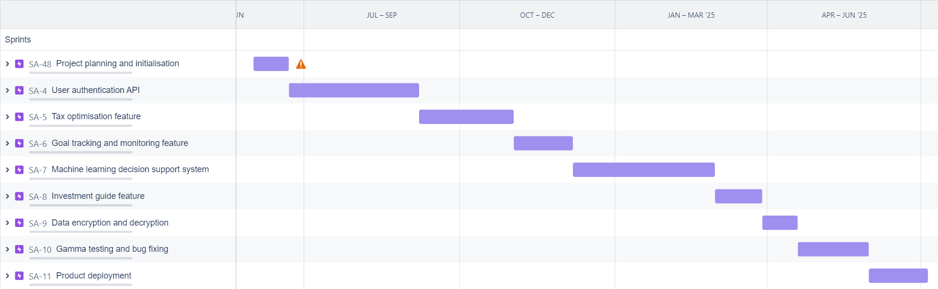
SCOPE AND TIMELINE

Slide 9
PROJECT PROGRESS AND ACHIEVMENTS
JUNE 2024
PROJECT PLANNING AND INITIALIZATION
JUNE 2024 - SEP 2024
USER AUTHENTICATION API
SEP 2024 - NOV 2024
TAX OPTIMISATION FEATURE
NOV 2024 - DEC 2024
GOAL TRACKING AND MONITORING FEATURE
DEC 2024 - FEB 2025
MACHINE LEARNING SUPPORT SYSTEM
MARCH 2025
INVESTMENT GUIDE FEATURE
MARCH 2025 - APRIL 2025
DATA ENCRYPTION AND DECRYPTION
APRIL 2025 - MAY 2025
GAMMA TESTING AND BUG FIXING
MAY 2025 - JULY 2025
PRODUCT DEPLOYMENT

Slide 10




BUSINESS ANALYTICS STRATEGY
PROPOSED TECH FOR SMARTPENSIONS
Deep Learning Ensemble Method
Convolutional Neural Network (CNN)
Recurrent Neural Network (RNN)
Feedforward Neural Network (FNN)
CNN
RNN
FNN
Predicted Output e.g. 51, 60, 55 (age of retirement)

Slide 11
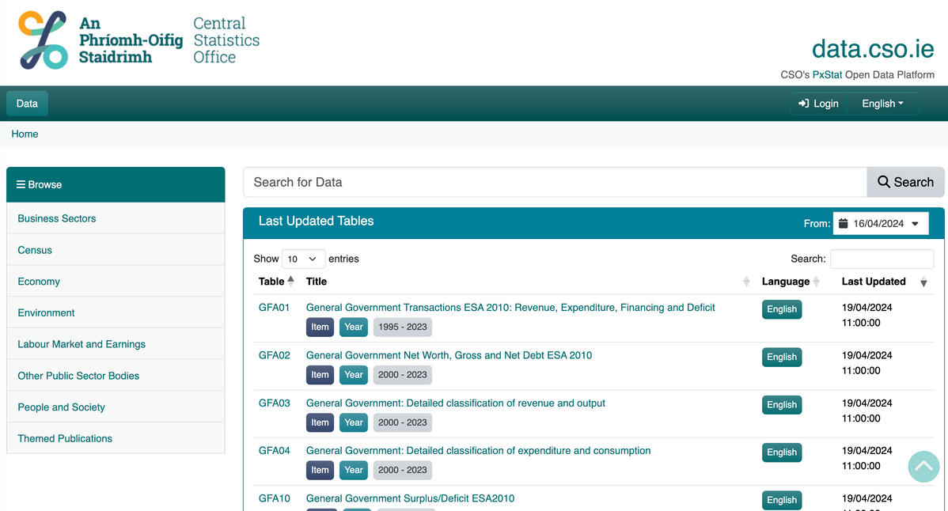
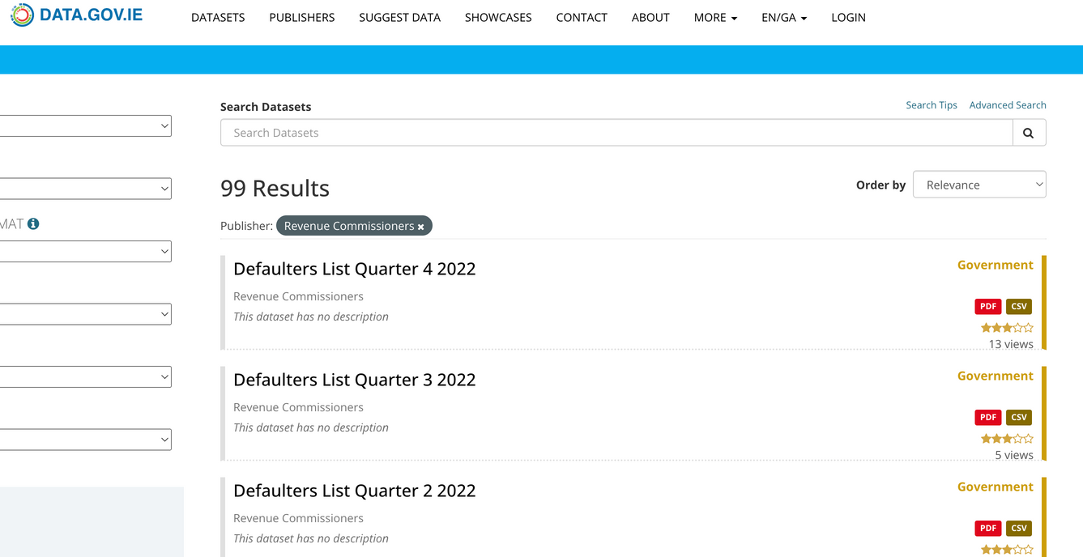
DATA SOURCES
OPEN SOURCE DATASET
Financial market for investment guide algorithm
Irish Stock Exchange (ISE)
Bloomberg dataset
Economics indicators and macro data for retirement planning algorithm
Central Statistics Office of Ireland
Tax data for tax optimisation algorithm
Revenue Commisioners
The dataset can be obtained from
data.gov.ie
data.cso.ie

Slide 12
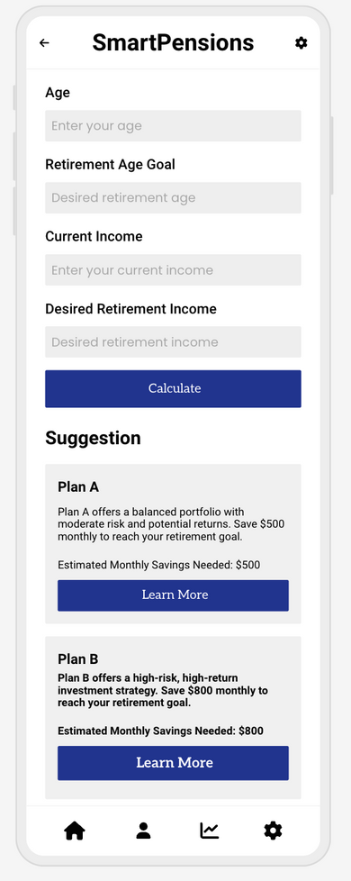
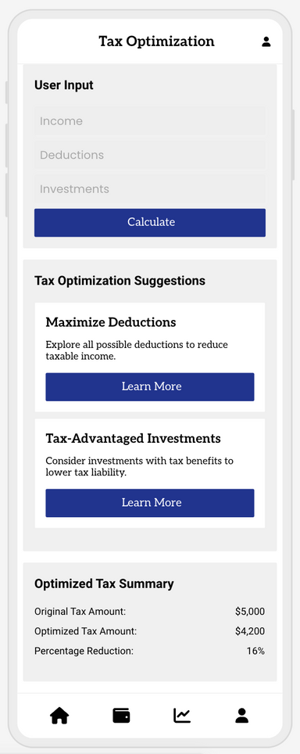
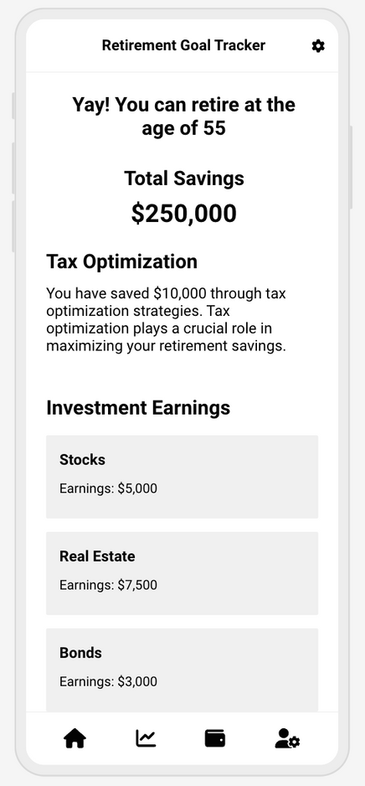

SMARTPENSIONS APP MOCKUPS
LOGIN PAGE
RETIREMENT PLANNER PAGE
TAX OPTIMISATION PAGE
GOAL TRACKER PAGE

Slide 13
CRITICAL RISKS AND MITIGATION
Risk Factor: Data Security
Mitigation:
State-of-the-Art Encrytion Techniques
Secured Data Storage
Regular Security Updates and Penetration Testing
Staff Trainings on Security Protocls
Risk Factor: Machine Learning Model Performance
Mitigation:
Extensive Model Training
Improcing Generalizability
Engage with ML experts
Perform Continuious Reviews
Stakeholder Management
Risk Factor: Project Management
Mitigation:
Strict and Continous Tracking of Tasks, Dependcies, and Deadlines
Regular Team Meetings to Ensure Expectations Management
Go AGILE!
Plan, Implement, Review, Repeat
Risk Factor: User Adoption
Mitigation:
User engagment during Planning
User engagement during Beta testing
Effective Marketing
Offer Free Trails + Customer Support

Slide 14
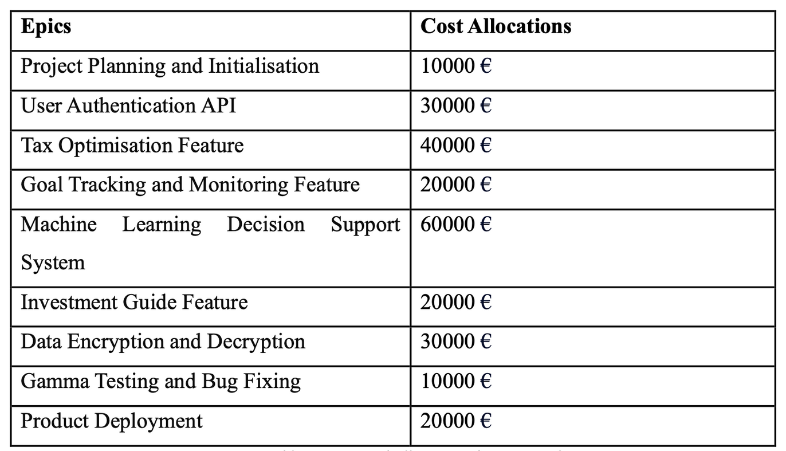
PROJECT BUDGET

Slide 15
THANK YOU
SMARTPENSIONS

